Slide 1
Instructions (Break the Ice: Self-Introduction Template)
This is the template you may use for your self-introduction presentation during the EU-CONEXUS Research Conference Ice Breaking Networking Activity.
Below you will find the structure that each slide should follow. A fictional character example will follow to help you understand how to complete the slides.
Please delete this slide, replace the content with your own information in the following slides, adjust the formatting as needed and save the file in PDF format for submission.
Slide Structure
1st slide (Introduce yourself)
Name & Surname
Name of the Entity/Organization & Logo
Is the Entity/Organization in the public or private sector?
What is the scope of the Entity/Organization, or what kind of products does it produce? (up to 1-2 lines)
Your Position in the Entity/Organization
Has this Entity/Organization participated in partnerships with Universities/Research Institutes to implement a project/activity/product? If yes, name such representative projects (up to 3 projects) (up to 3-5 lines in total)
Which activities/kind of products of your Entity/Organization are related to the challenges this conference focuses on (up to 3 activities/kind of products) (up to 3-4 lines in total)
2nd slide (Collaboration Opportunities)
Project(s) for which you are interested in collaborating with Universities/Research institutes
3rd slide (Collaboration Opportunities)
Project(s) for which you are interested in collaborating with Universities/Research institutes

Slide 2



Georgia Papa
Entity: Nireus Aquaculture Company
Sector: Private
Scope or Products: Provide Fisheries to the Market
My Position: Chief Executive Officer
Partnerships with Universities:
Agricultural University of Athens (project: AquaFish)
University of Patras (projects: FishCulture, FishDone)
Activities/Products related to this Conference: fish farming, fish processing, fish quality and nutrients

Slide 3
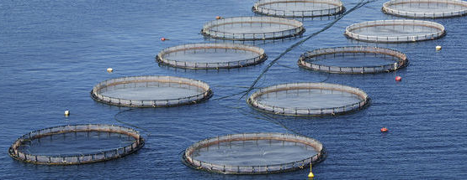
Use Biocontrol approaches to reduce the use of antibiotics in Sea Bream farming
Free Context
Make your own slide

Slide 4
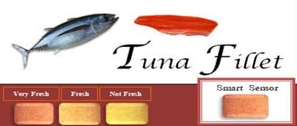
Introduce the smart labeling on Fish products
Free Context
Make your own slide

Slide 5
Thank you!
Georgia Papa
Chief Executive Officer, Nireus Aquaculture Company
📧 gpapa@nireus.com

