Slide 1
Instructions (Break the Ice: Self-Introduction Template)
This is the template you may use for your self-introduction presentation during the EU-CONEXUS Research Conference Ice Breaking Networking Activity.
Below you will find the structure that each slide should follow. A fictional character example will follow to help you understand how to complete the slides.
Please delete this slide, replace the content with your own information in the following slides, adjust the formatting as needed and save the file in PDF format for submission.
Slide Structure
1st slide (Introduce yourself)
Name & Surname
University/Research Institute in which your research activities take place & Logo
Laboratory in which your research activities take place
Head of Laboratory
Degree Programme (MSc / PhD Programme Title)
Supervisor(s)
Main Research Topic
Scientifically Responsible Researcher of your research topic (who is/will be the corresponding author in the publication of your scientific results?)
2nd slide (Details on your Research topic)
Your Research topic
Your Research topic described using figures
Your research methodology in brief
Your publications, if any, related to this research topic
What is the source of funding for your research activities on your topic? (for example, Horizon X, Fellowship X)
Which scientific session of this conference matches your research topic?

Slide 2



Maria Papadaki
PhD Candidate, University of the Aegean Marine Environmental Dynamics Laboratory
Head of Lab: Prof. Dimitris Alexandridis
PhD Programme in Marine Environnemental Science
Main Research Topic: Monitoring microplastic pollution and trophic transfer in semi-enclosed Mediterranean coastal systems
Supervisor: Assoc. Prof. Sofia Markou
Scientific Responsible Researcher: Assoc. Prof. Sofia Markou

Slide 3
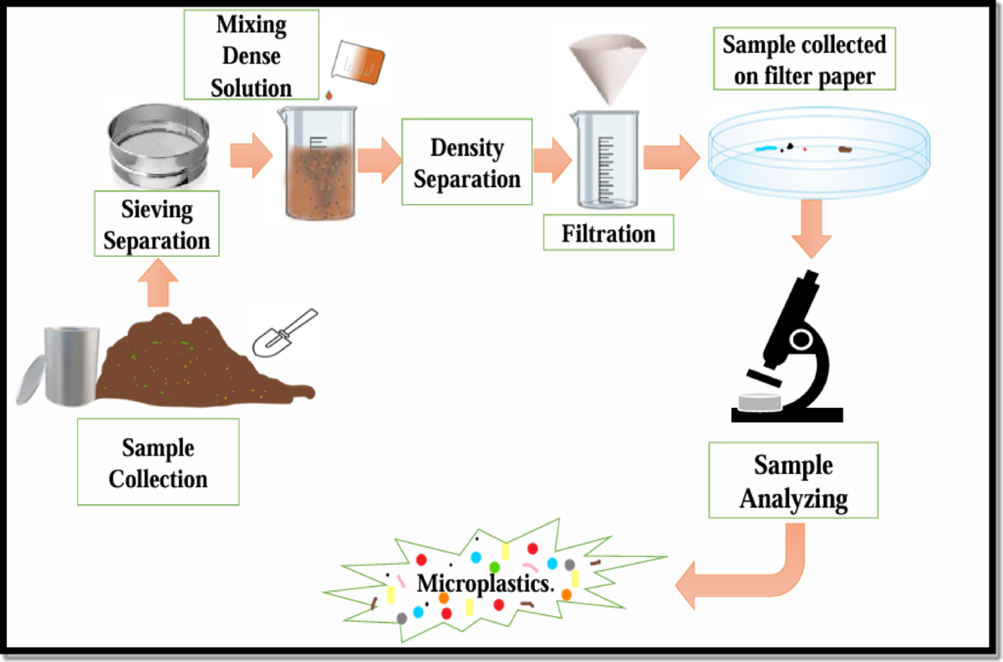
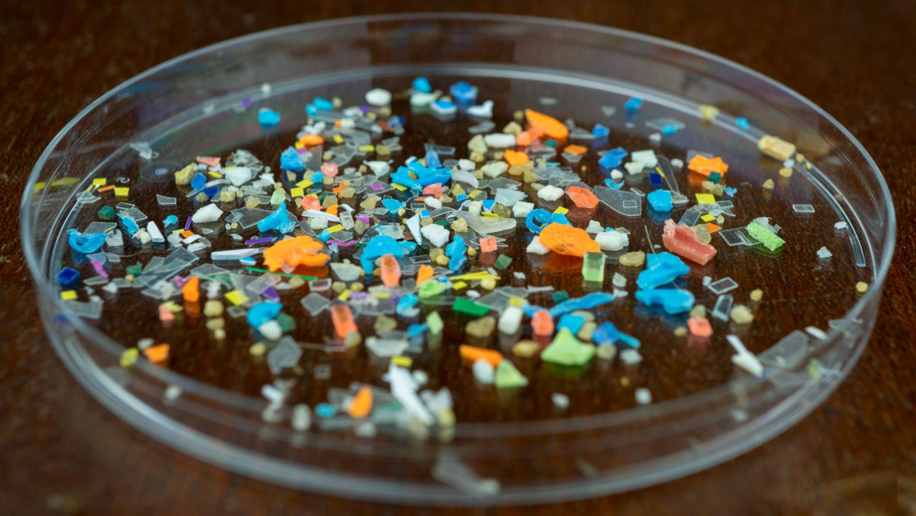
Monitoring microplastic pollution and trophic transfer in semi-enclosed Mediterranean coastal systems
RESEARCH METHODOLOGY
Coastal sampling in semi-enclosed Mediterranean bays
Laboratory filtration and particle isolation
Microscopic identification and classification
Source of funding
Horizon Europe – Mission Ocean & Waters (Project: MICROTRACK)
RELATED PUBLICATIONS
Papadaki, M., Markou, S., & Rossi, L. (2025). Microplastic accumulation patterns in Aegean coastal waters. Marine Pollution Bulletin (under review).
Matching EU-CONEXUS Conference Session
Session 2: Protection of Oceans, Seas & Waters and Sustainable Coastal Waste Management through Socio-Ecological Transitions

Slide 4
Thank you!
Maria Papadaki
PhD Candidate, University of the Aegean
📧 mpapadaki@aegean.gr

