Slide 1
Instructions (Break the Ice: Self-Introduction Template)
This is the template you may use for your self-introduction presentation during the EU-CONEXUS Research Conference Ice Breaking Networking Activity.
Below you will find the structure that each slide should follow. A fictional character example will follow to help you understand how to complete the slides.
Please delete this slide, replace the content with your own information in the following slides, adjust the formatting as needed and save the file in PDF format for submission.
Slide Structure
1st slide (Introduce yourself)
Name & Surname
Position
University/Research Institute & Logo
Laboratory
Head of the Lab
Your most important Research topics (up to 2)
2nd slide (Details on Research topic 1)
Research topic 1 described using figures
Your 2-3 most important publications related to this research topic
Your Collaborators
What is the source of funding for research topic 1? (for example, Horizon X, Fellowship X)
For what research topic 1-related call are you interested in finding collaborators? (for example, Horizon X)
Which scientific session of this conference matches your research topic 1?
3rd slide (Details on Research topic 2)
Research topic 2 described using figures
Your 2-3 most important publications related to this research topic
Your Collaborators
What is the source of funding for research topic 2? (for example, Horizon X, Fellowship X)
For what research topic 2-related call are you interested in finding collaborators? (for example, Horizon X)
Which scientific session of this conference matches your research topic 2?

Slide 2



Dr Sofia Markou
Associate Professor, University of the Aegean Marine Environmental Dynamics Laboratory
Head of Lab: Prof. Dimitris Alexandridis
Research Topics:
Nature-Based Coastal Protection & Climate Adaptation
Microplastic Pollution Monitoring & Socio-Ecological Impact

Slide 3
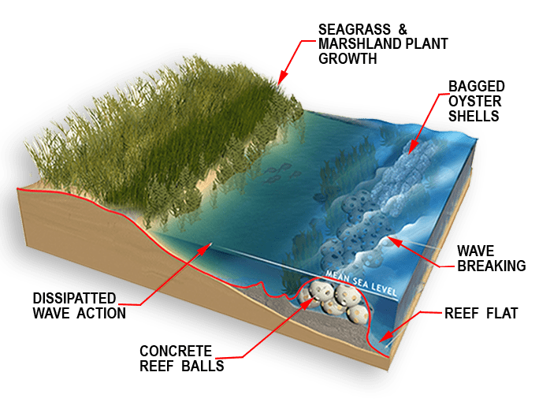
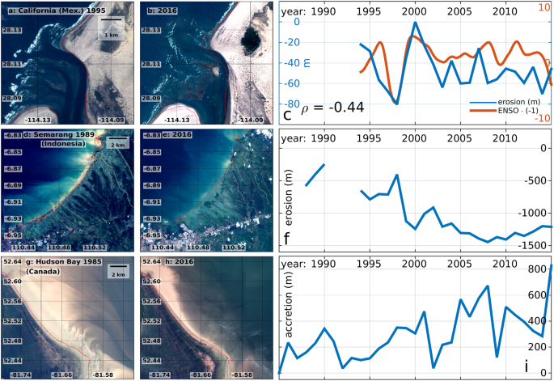
Nature-Based Coastal Protection & Climate Adaptation
Funding Source
COLLABORATORS
Horizon Europe – Mission Adaptation, Horizon X (Project: MED-RESILIENCE)
University of Bologna
Hellenic Centre for Marine Research
Municipality of Rhodes
RELATED PUBLICATIONS
Markou, S., Rossi, L., & Alexandridis, D. (2023). Evaluating the effectiveness of nature-based coastal defence systems in Mediterranean estuaries. Coastal Engineering Journal, 65(4), 215–232.
Rossi, L., & Markou, S. (2022). Ecosystem-based adaptation strategies for climate resilience in semi-enclosed seas. Environmental Research Letters, 17(9), 094012.
Matching EU-CONEXUS Conference Session
Session 3: Infrastructure & Nature Based Solutions for Disaster Risk Reduction and Climate Change Adaptation with Local Knowledge & Cultural Practices
Looking for Collaborators For
HORIZON-CL6-2026-CLIMATE-01: Nature-based solutions for climate resilience and coastal adaptation

Slide 4
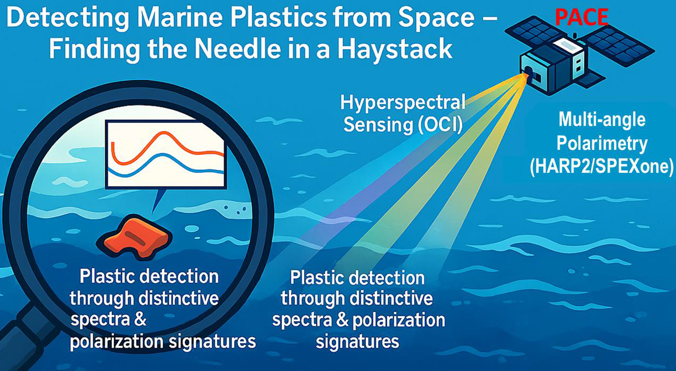
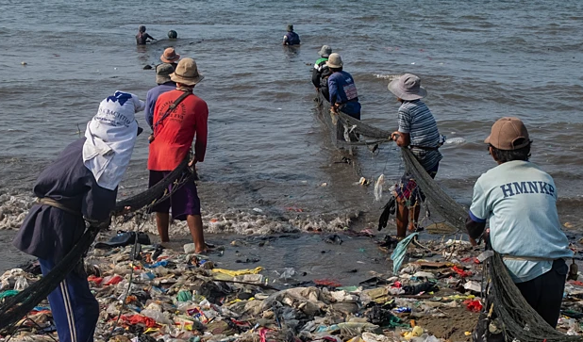
Microplastic Pollution Monitoring & Socio-Ecological Impact
Funding Source
COLLABORATORS
Horizon Europe – Mission Ocean & Waters, HORIZON X (Project: MICROTRACK)
University of Barcelona
National Technical University of Athens
Clean Seas Initiative (NGO)
RELATED PUBLICATIONS
Markou, S., Papadakis, N., & Rossi, L. (2024). Spatial distribution patterns of microplastics in semi-enclosed Mediterranean basins. Marine Pollution Bulletin, 198, 115732.
Papadakis, N., & Markou, S. (2023). Citizen science approaches for monitoring coastal plastic pollution. Science of the Total Environment, 872, 162045.
Matching EU-CONEXUS Conference Session
Session 2: Protection of Oceans, Seas & Waters and Sustainable Coastal Waste Management through Socio-Ecological Transitions
Looking for Collaborators For
HORIZON-CL6-2026-01-ZEROPOLLUTION-01-two-stage Decontaminate and bioremediate aquatic pollution

Slide 5
Thank you!
Dr Sofia Markou
Associate Professor, University of the Aegean
📧 smarkou@aegean.gr

