Slide 1
EU-CONEXUS
European University for Smart Urban Coastal Sustainability

Slide 2

European Universities transforming higher education in Europe by
PROMOTING
European values ↗
and identity
REVOLUTIONISING
the quality ↗ and competitiveness ↗
of European higher education
CREATING
unique inter-university
campuses in Europe.
64 European University alliances involving more than 560 higher education institutions from all across Europe
including all EU Member States, Albania, Bosnia
and Herzegovina, Iceland, Montenegro, Norway,
the Republic of North-Macedonia, Serbia and Turkey.
Notes:
Linking EU-CONEXUS back to the initiative of the European Commission.

Slide 3
Timeline
2020 December
Frederick University became associated partner
2019 September
START DATE
2020 July
Waterford Institute
of Technology became associated partner
2022 November
9
18
universities and
associated partners
6
13
universities and
associated partners
2020
2021 – 2022
2023
La Rochelle Université
Agricultural University of Athens Catholic University of Valencia
Klaipeda University
University of Zadar
Technical University of Civil Engineering Bucharest
2020 October
Rostock University became associated partner
2022 October
EU-CONEXUS AISBL – EU-CONEXA established

Slide 4
Associated partners
Cooperation
La Rochelle Urban Community
Regie du Port de Plaisance de La Rochelle
Region Nouvelle-Aquitaine
City of La Rochelle
Grand Port Maritime of La Rochelle
Fundación Valencia Port
Klaipeda State Seaport Authority
Klaipėda Science and Technology Park
Klaipėda City Municipality
Tankerska plovidba d.d.
Croatian Chamber of Economy
City Hall of District 2, Municipality of Bucharest
Waterford Chamber of Commerce
Southern Regional Assembly
Hanseatic City of Rostock
Municipality of Limassol
Cyprus Ports Authority-Limassol Port
Ayia Napa municipality
International memberships
Agence universitaire de la Francophonie (AUF)
European Civil Engineering Education and
Training Association (EUCEET)
International partnerships
Africa Center of Excellence in Coastal Resilience (ACECoR) of University of Cape Coast (Ghana, Africa)
Ukraine Odessa I.I. Mechnikov National University

Slide 5
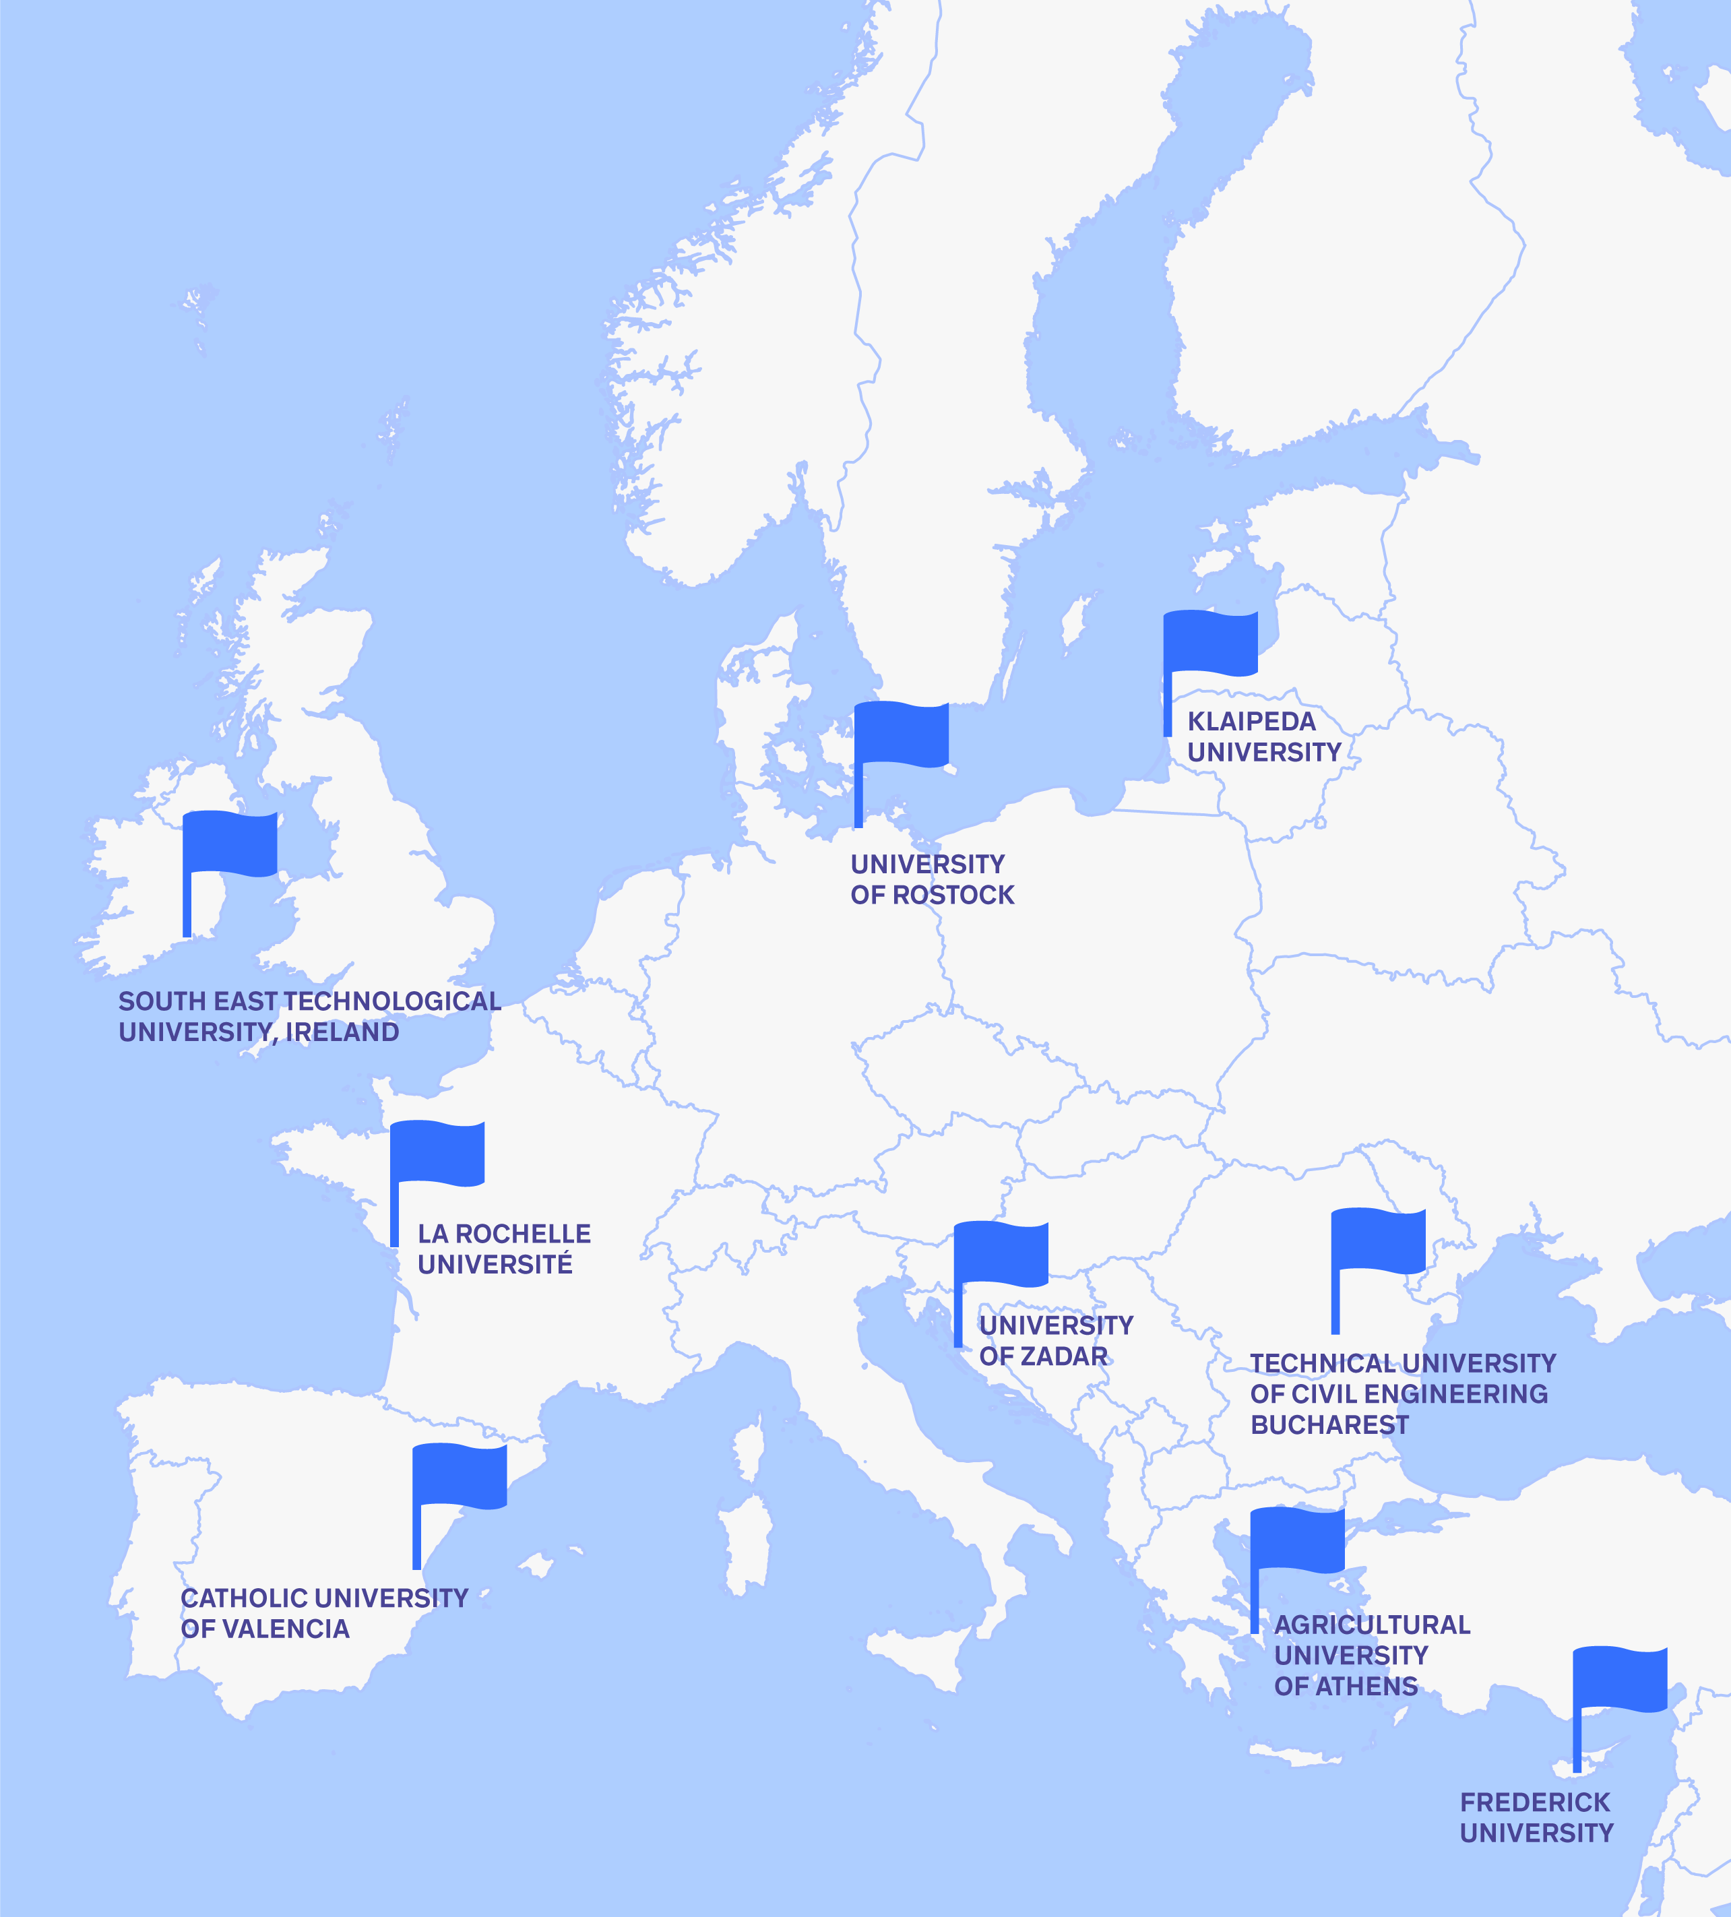
A strong partnership covering European coasts
9 Universities together are building a European University for Smart Urban Coastal Sustainability.

Slide 6
Who are we:
We are
a European University for Smart
Urban Coastal Sustainability
We promote
European values and identity
by bringing together a new generation of European citizens
⁹
^{partner}
^{Universities}
^{associated partners}
¹⁸
We
create
a European University which focuses on four core strategic missions: education, research, innovation and service to society
We are building
the University of the Future focusing on European coasts

Slide 7

Thematic focus
Smart Urban Coastal Sustainability is a unique thematic focus that concentrates all university missions on finding solutions to global societal challenges faced by urbanised and semi-urbanised coastal areas.
The “land-sea” interface is the first area
threatened by the climate transition and
the rise of the oceans.
These societal challenges are global in scope, since 60% of
the global population lives within
100km of the coast
Notes:
To use this comment for explanation: The thematic focus creates a unique competitive advantage for EU- CONEXUS which is well positioned to assemble and build on thematic expertise from all its partners and regional ecosystems, through inter- and transdisciplinary based approaches.

Slide 8

Main objectives of the European University for Smart Urban Coastal Sustainability
Focus all university missions on
a global societal challenge: Smart Urban Coastal Sustainability (SmUCS)
Develop innovation-led services to society
Create a transnational inter-university campus with seamless mobility for all
Provide internationally-renowned quality
of education
Foster challenge-driven excellent research on SmUCS themes
Notes:
Smart Campus needs to be replaced with something else

Slide 9
Values
As a European higher education and research institution academic freedom is a key value for all of our activities.
Responsiveness to societal
challenges as the starting point for the design
of all university missions.
The promotion of diversity, inclusiveness,
gender equality and non- discrimination of
any kind is a basic principle of our organisational behaviour.
We adhere to the principle of sustainability
and align with the UN Sustainable
Development Goals.
Notes:
Smart Campus needs to be replaced with something else

Slide 10
EU-CONEXUS in numbers
Students
Staff
Programmes
69 032
8 035
899
218
51 658
14 185
3 189
9 264
1 248
Bachelor
Master
Ph.D.
Foreign
Vocational
4 928
2949
288
Teaching / Research
Administrative
Other (technical,
infrastructure)
347
375
114
63
Bachelor´s
Master´s
Ph.D.
Postgraduate
specialised studies
Research
institutes
Notes:
update statistics

Slide 11

A new role model of collaborative university

Slide 12

EU-CONEXUS AISBL – EU-CONEXA
TESTING A tool FOR ADMINISTRATIVE INTEGRATION OF THE ALLIANCE
Mission
To promote and coordinate
the four EU-CONEXUS missions
To develop and implement a long-term partnership and cooperation strategy based on a common vision and values in relation to the four missions
International non-profit association (in french, Association Internationale Sans But Lucrative – AISBL) was created under Belgian law for the management of EU-CONEXUS.

Slide 13
EU-CONEXUS AISBL – EU-CONEXA
TESTING A tool FOR ADMINISTRATIVE INTEGRATION OF THE ALLIANCE
Association governance
General Assembly:
Composed of the Members represented
each by its Rector.
President of The General Assembly:
Appointed by the General Assembly,
the President chairs the General Meetings
and meetings of the Executive Board.
Executive Board:
Appointed by the General Assembly,
the Executive Board steers the operational management of the Association.
Directors:
Appointed by the General Assembly,
the Directors take care of the operational management of the Association.
International non-profit association (in french, Association Internationale Sans But Lucrative – AISBL) was created under Belgian law for the management of EU-CONEXUS.

Slide 14
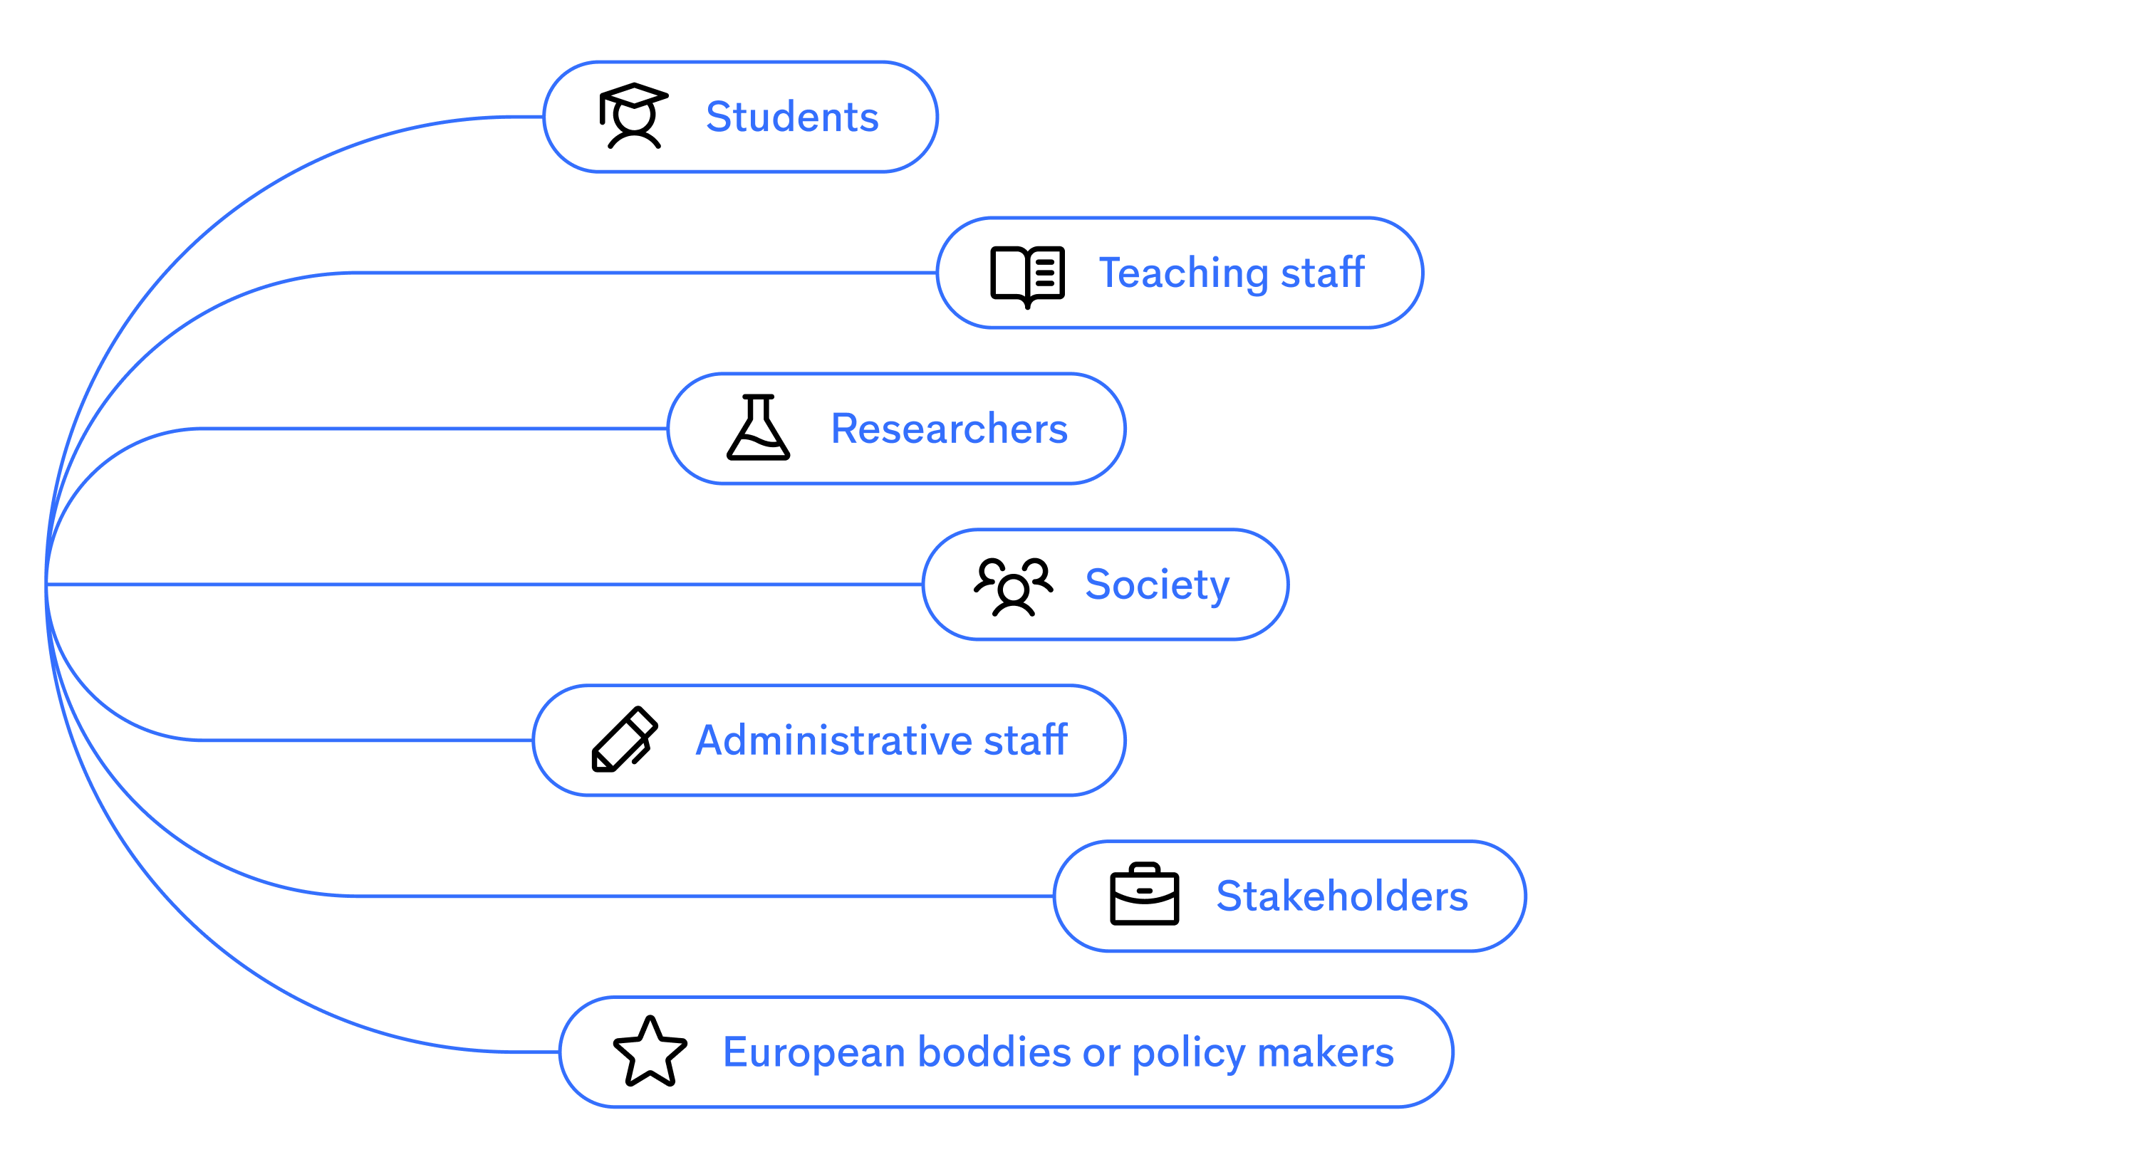

Target audiences
Notes:
Prospective students

Slide 15

EU-CONEXUS for students
Inter/multidisciplinary
knowledge and flexible curriculum
Grants, scholarships and funds for student projects
Innovation contests
We open up opportunities to enroll at one university, be a student of 9
Open Lab Hours and
Student Research Hub
International campus life
Cultural and
artistic activities
International job offers and internships
Tackling global social and environmental challenges
Notes:
Comment (David): Be a student of 9 (instead of 6)
and maybe we can add here:
-ALUMNI CLUB
-STUDENT AMBASSADOR PROGRAMME
-CAREER CENTRE
maybe even a Buddy system if we are planning to reactivate...

Slide 16
EU-CONEXUS for Bachelor students
Minor Programmes
Micro-credentials
30 different 6 ECTS courses in two fields:
Minor in Coastal Development and
Sustainable Maritime Tourism
Minor in Blue Economy and Growth
We offer short learning experiences with possibilities
to get extracurricular knowledge in Smart Urban Coastal Sustainability topics.
Challenge-based Projects
Upon completing five courses in a Minor Programme an official specialisation certificate is awarded.
Our stakeholders (cities, ports and other companies)
offer challenges to get hands-on experience, paired or complementary to study programmes.
Notes:
Joint degrees/programmes to highlite

Slide 17

EU-CONEXUS for Master students
Joint Master Programme
in Marine Biotechnology
Specialise in one of our four thematic pathways:
Innovative Bioproducts for Future
Blue Biomass
Marine Biorefinery
Aquaculture Biotechnology
Micro-credentials
We offer short learning experiences with possibilities
to get extracurricular knowledge in Smart Urban Coastal Sustainability topics
Notes:
Joint degrees/programmes to highlite

Slide 18
EU-CONEXUS for PhD students
EU-CONEXUS Co-tutelle
PhD Courses
PhD programme offered to doctoral candidates enrolled and jointly supervised at two EU-CONEXUS universities, including research stays at each university. The PhD thesis will be defended only once.
Courses developing transversal competencies
and SmUCS-related skills offered by each partner university of the Alliance.
PhD Summer Schools
PhD Funding Opportunities
Focus on transversal competencies to improve researchers’ careers.
Grants
Seed funding
Research mobility
Scholarships
PhD Weeks
Information sessions/workshops about new research
and academic opportunities for PhD students.

Slide 19

EU-CONEXUS for Research staff
We open up opportunities to an international curriculum, career and experience
Shared research information system
& infrastructures
Career trainings: workshops, research hours, networking events, conferences
International joint projects
and collaborations
Funding for: project development, mobility and international conferences, invitation of guest researchers, Seed funding
Contact point for Technology Transfer
and Innovations
Notes:
to check with new brochure info

Slide 20

EU-CONEXUS for Teaching & Administrative staff
We open up opportunities to an international
career and experience
International staff training weeks
Specialised professional trainings
Exchange of good practice: job shadowing
Multicultural experience & language courses
Office for Development of Study Offers
and Financial Support

Slide 21

EU-CONEXUS for Society
We Open up opportunities to bring innovations to your town
Raising awareness on coastal area challenges: exhibitions, science festivals, public conferences
Green Campus
Promotion of national cultures through cultural festivals and sport events
University to school actions: school contests, workshops, fairs

Slide 22

EU-CONEXUS for Stakeholders
we Open up Opportunities to University - Industry cooperation
Industry needs-based study programmes and courses
Involvement of stakeholders into teaching and training
Stakeholder‘s Academy
Networking and events
Access to pool of talents
Research-based innovative solutions

Slide 23
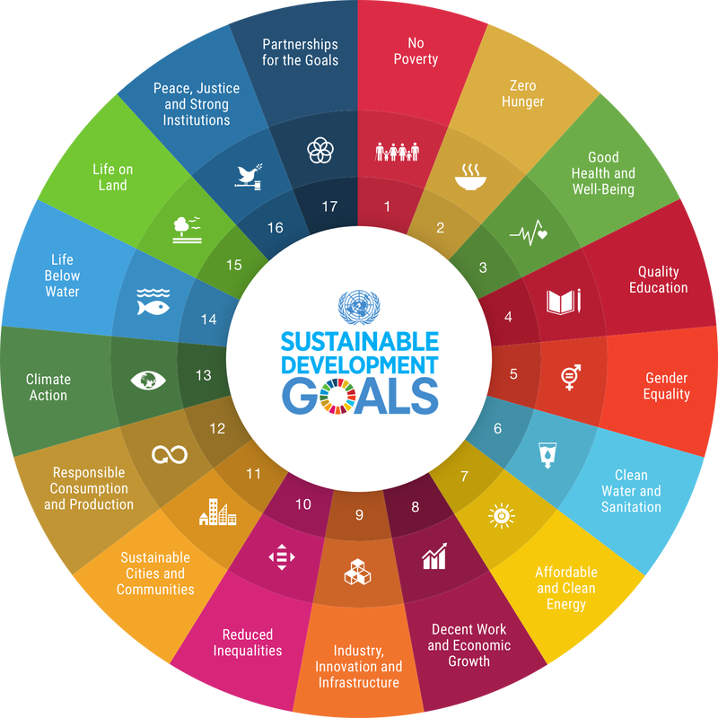
EU-CONEXUS impact
The Universities’ impact on society
and the world at large is undeniable.
Therefore we are committed to supporting the United Nations’ Sustainable Development Goals (SDGs) and contributing meaningfully to a sustainable future for all, through education, research, and community engagement.

Slide 24
Joint services and IT tools
Career Centre
Space on the Job Teaser platform where each European University student can register and explore all the listed companies to get the perfect job or internship. Our career advisors are also accessible for one-on-one sessions to assist with career exploration, enhance employability skills, and facilitate successful job applications, and attend job fairs.
Project development
support office (PDSO)
Office for Development of Study Offers (ODSO)
Assists to the EU-CONEXUS academic community (teacher-researchers, researchers or administrative staff) working in any university of the alliance by helping them apply to external calls for proposals. The PDSO has also put in place its own funding opportunities with the goal of enhancing collaboration among partners within the alliance.
The first and only point of contact for developing
EU-CONEXUS study offers who guides teachers step-by-step from the beginning to the end of the process, cooperates with corresponding structures at partner institutions and coordinates activities of all EU-CONEXUS bodies and structures that might be involved in programme design, development and accreditation.

Slide 25
Joint services and IT tools
Research & Innovation Information System
Online database for easy search of researchers, research support staff, research units, infrastructures and services offered, research thematics and projects in EU-CONEXUS partner institutions.
EU-CONEXUS OpenAIRE Gateway
Innovation Hub
The EU-CONEXUS OpenAIRE Gateway is an open science platform providing access to open access resources of all EU-CONEXUS partner institutions.
Social space for investors, entrepreneurs and researchers to identify innovation opportunities and initiate new ideas. One-stop-shop for business representatives looking for ready-made innovative products and solutions. A partnering tool for industry searching for interactive partners.

Slide 26
Projects
Global strategic
projects
Educational projects
Strategic partnerships
EU-CONEXUS
(Erasmus+, 2019-2022)
EU-CONEXUS Plus
(Erasmus+, 2022-2026)
EU-CONEXUS Research for Society
(H2020, 2020-2024)
EU-CONEXUS ENABLES
(Horizon Europe, 2024-2029)
EU-CONEXUS Joint Master Programme on Marine Biotechnology (Erasmus Mundus Joint Programmes,
2022-2027)
EU-CONEXUS Digital Humanities Joint Master (Erasmus Mundus Design Measures, 2022-2023)
European Degree: Advancing, Facilitating and Fostering International Collaboration
in Higher Education ED-AFFICHE (Erasmus+, 2023-2024)
Strategic partnership on Student engagement (Erasmus+, 2020-2023)
Sport Handicap Inclusive Experience – SHIE
(Erasmus +, 2021-2024)
Building Student Identity for European Universities Alliances (IamSTUDENT) (Erasmus +)

Slide 27
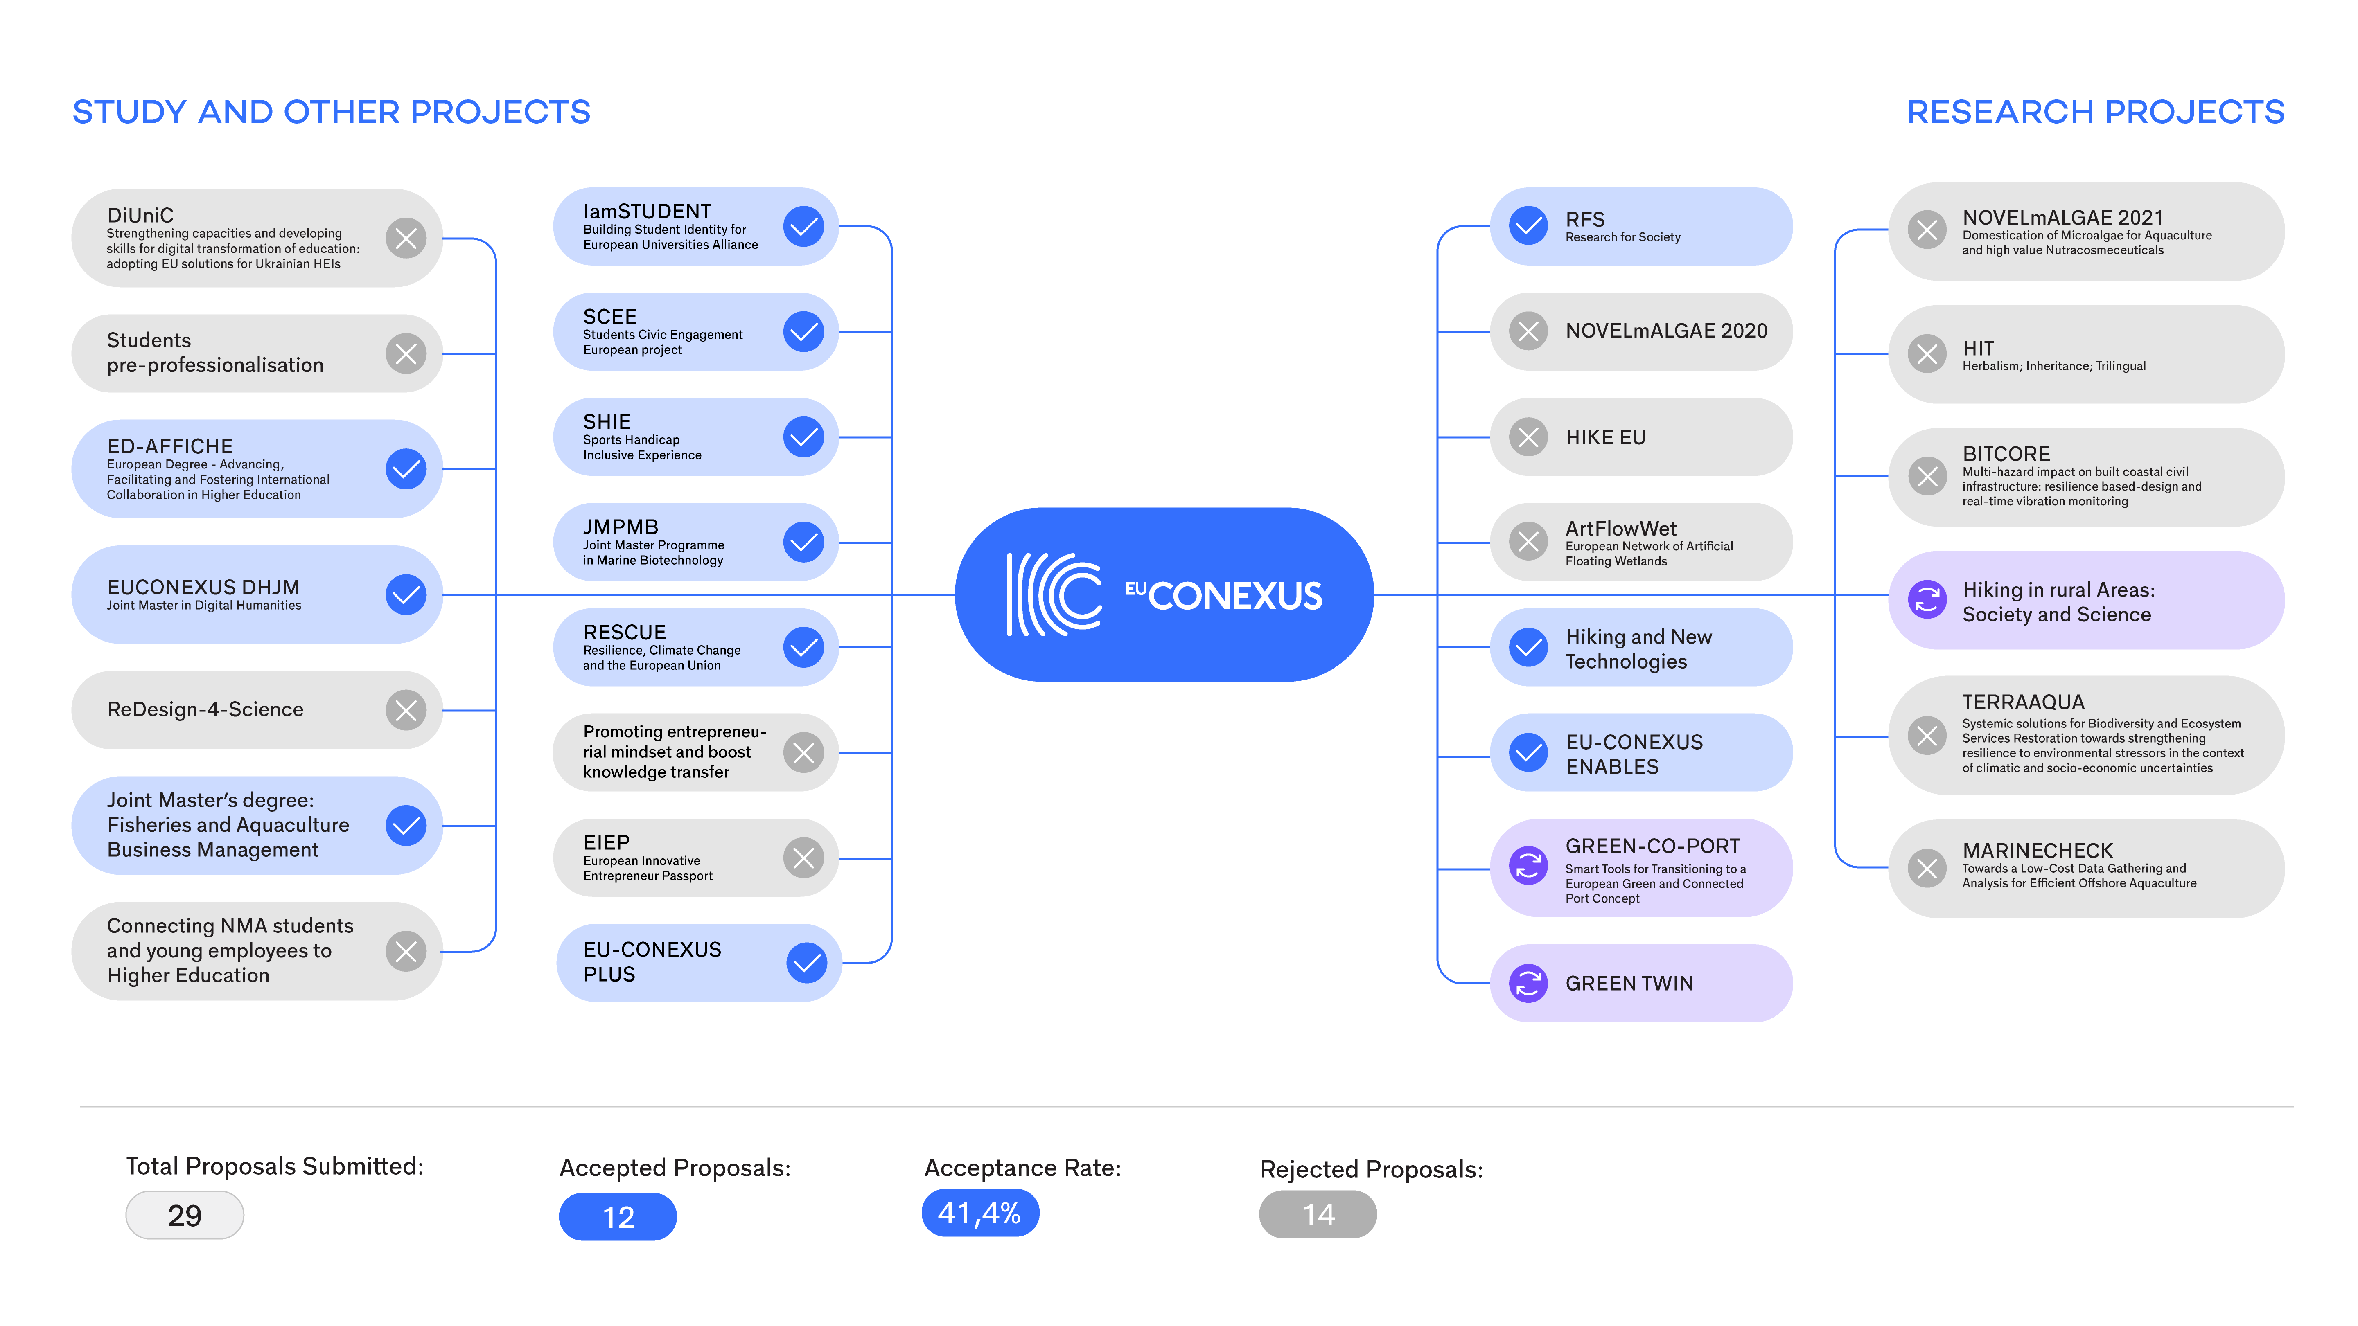

Slide 28
EU-CONEXUS challenges
Diverse legislative frameworks (studies, degrees, administration...)
Difficulties with foreign languages (English is the main Alliance language
but not spoken by all our community)
Creating a "sense of belonging" to the Alliance staff and students.
Low labour market and academic recognition of international diplomas
Lack of collaborative
tools and common IT infrastructures
Unbalanced recognition
of European Approach
for accreditation of joint programmes in national processes
Difficulties to synchronize academic calendars for
joint offers
Challenge of sustainability of the Alliance without long-term funding

Slide 29
Contact us
Name / Surname - Contact email - Phone number
Follow us
@eu.conexus
@eu.conexus
@eu_conexus
@eu_conexus
DISCLAIMER. Funded by the European Union. Views and opinions expressed are however those of the author(s) only and do not necessarily reflect those of the European Union or EACEA. Neither the European Union nor the granting authority can be held responsible for them.
info@eu-conexus.eu
www.eu-conexus.eu
Notes:
change Thank You! to “Contact us”
social media icons here

