Slide 1
EU-CONEXUS:
European University for Smart Urban Coastal Sustainability
7 June 2022

Slide 2

European Universities transforming higher education in Europe by
promoting European values and identity,
revolutionising the quality and competitiveness
of European higher education,
creating unique inter-universities
campuses in Europe.
They are a unique opportunity in the long-term
to design student-centred curricula across disciplines, boarders, cultures and languages,
to build multi- and trans-disciplinary skills for students, academics, cities, companies working together to tackle society’s greatest challenges delivering common European diploma.

Slide 3
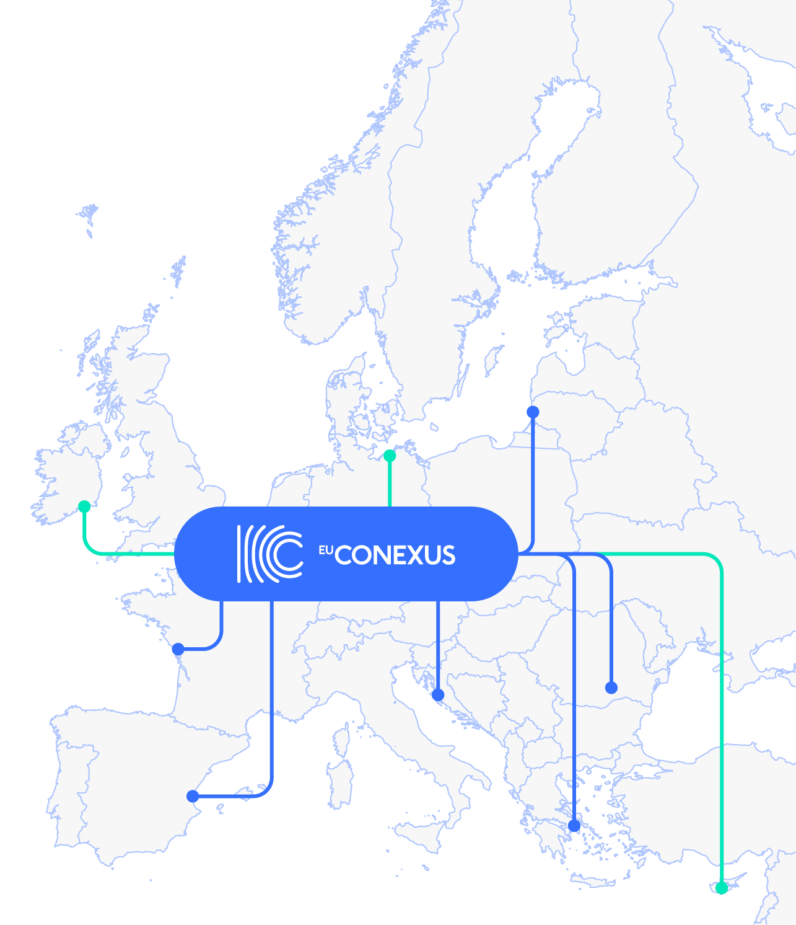
A strong partnership covering European coasts
6 Universities together have built European University for Smart Urban Coastal Sustainability.
3 more universities have joined as associated partners.

Slide 4
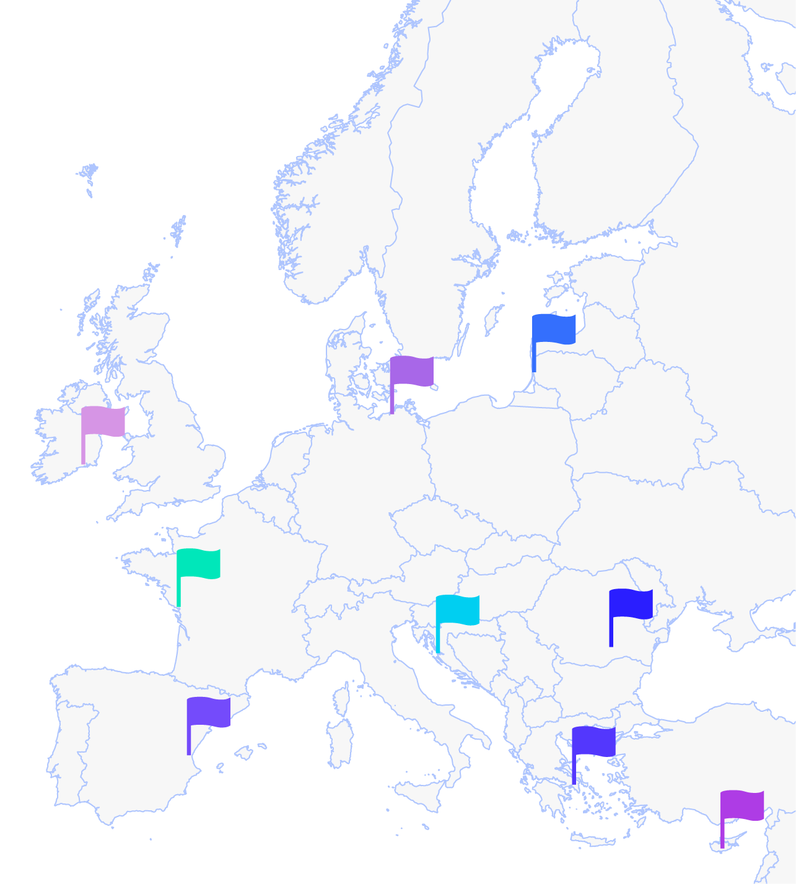
La Rochelle Université, France
Technical University of Civil Engineering of Bucharest, Romania
A human-sized university specialising in Smart Urban Coastal Sustainability issues.
We build education in engineering since 1818 in Romania.
Universidad Catolica de Valencia, Spain
Agricultural University of Athens, Greece
Partners
Professional and personal growth of students, staff and society.
Provides a high level of Education and Research since 1920.
University of Zadar, Croatia
Klaipeda University, Lithuania
A space of creativity and transfer of new knowledge and technologies.
A national and Baltic Region leader in the field of marine sciences.
Waterford Institute
of Technology
The University of Rostock
Frederick university
Associated
partners
Education-focussed collaborative, inclusive, ethical and innovative community
University's motto "Traditio und Innovatio"
Assists students achieve the maximum of their potential and empowers them to have a positive impact to society.

Slide 5
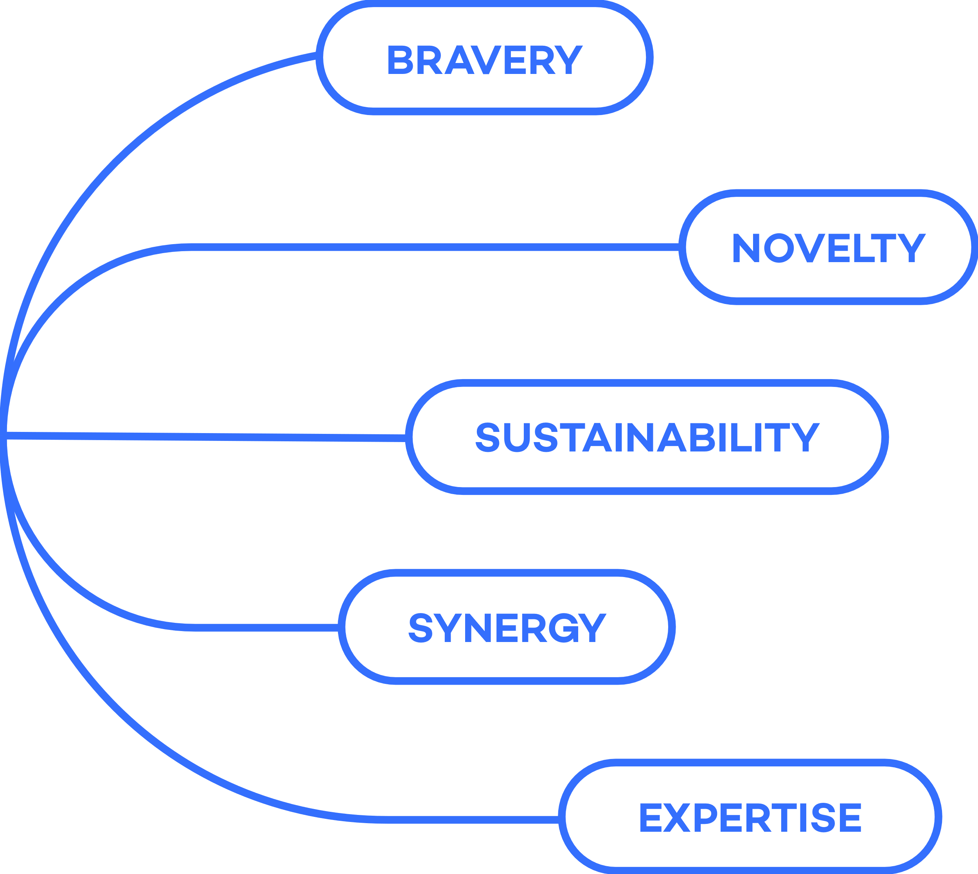
Gathered around the same
values

Slide 6
EU-CONEXUS opens up opportunities :
TO EDUCATION THROUGH NEW GENERATION OF EUROPEAN UNIVERSITIES
to sustainable development
of urban coasts
to create blue economy in your
city and in Europe
to act globally
to 6 coasts
to local experts to solve
global challenges

Slide 7

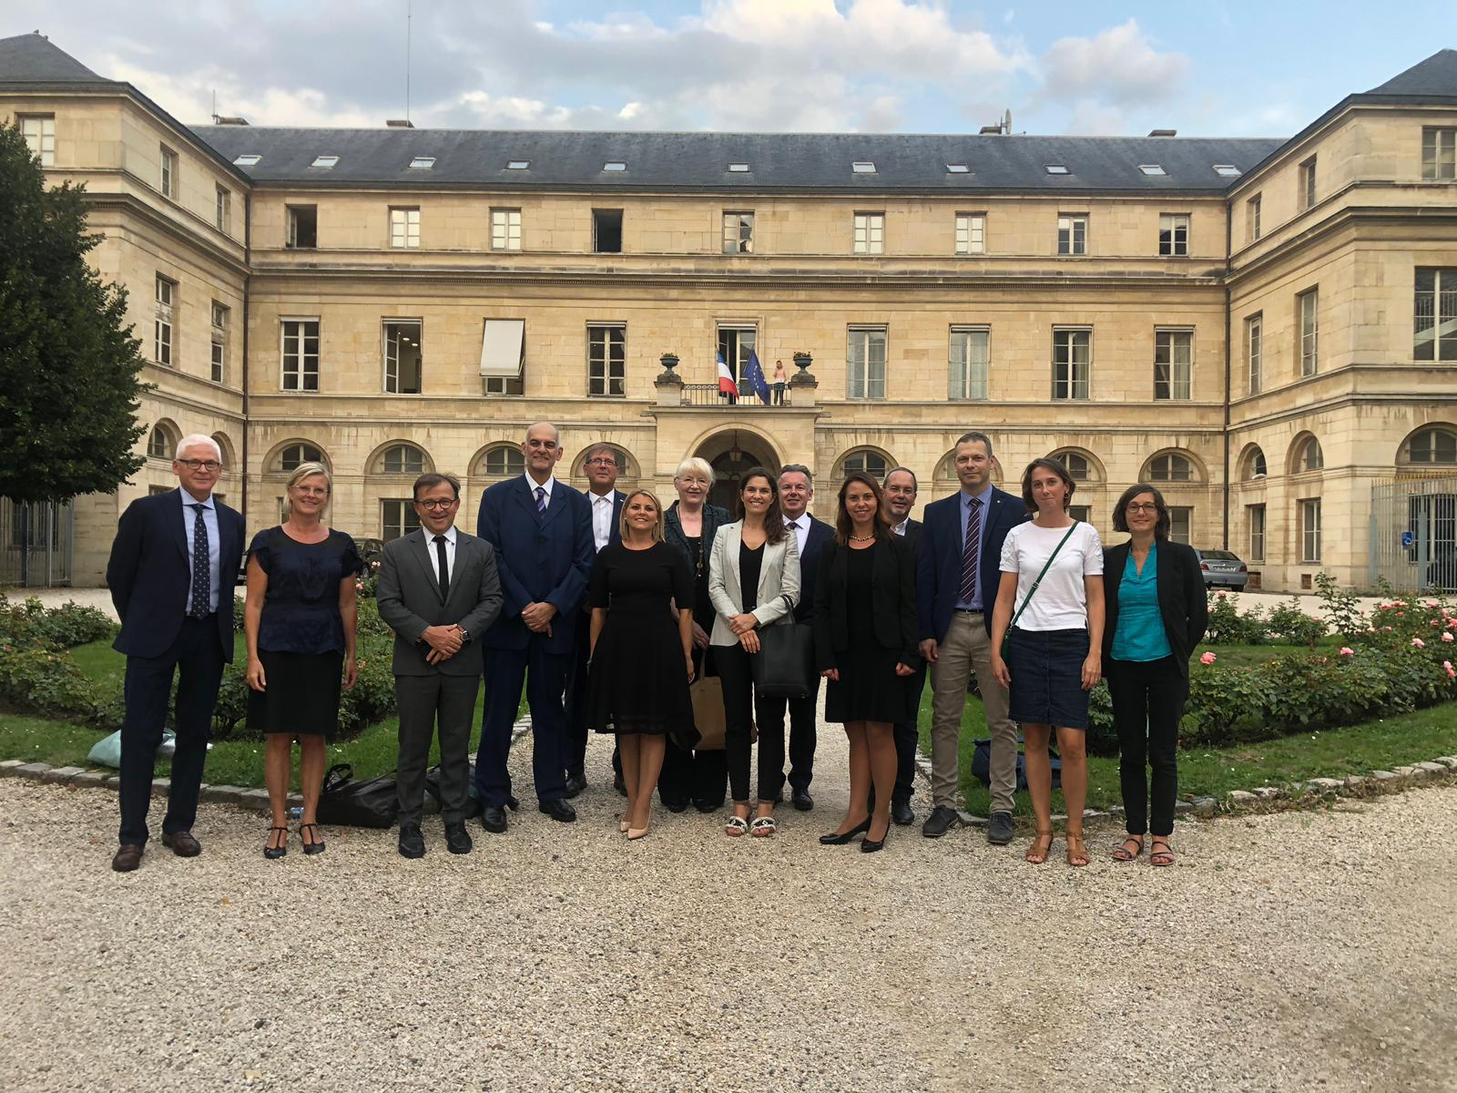
One of the 17 first ‘Universities of the Future’
Project No: 612599-EPP-1-2019-1-FR-EPPKA2-EUR-UNIV​
Start: 01/09/2019​
End: 31/08/2022​
Duration: 36 months
Budget EU-CONEXUS: € 5,645,079.25​
EU grant : € 4,516,063.00
Kick-off meeting in Paris, 28 08 2019

Slide 8


One of the 17 first ‘Universities of the Future’
Project No: 612599-EPP-1-2019-1-FR-EPPKA2-EUR-UNIV​
Start: 01/09/2019​
End: 31/08/2022​
Duration: 36 months
Budget EU-CONEXUS: € 5,645,079.25​
EU grant : € 4,516,063.00
Kick-off meeting in Paris, 28 08 2019

Slide 9
Building an EU-CONEXUS community
4,1223
5,421
396
students
Staff
programmes
30981
Bachelor´s
3592
Teaching/Reaserch
168
Bachelor´s
8004
Master´s
1581
Administrative
189
Master´s
1638
Ph.D.
248
Other (technical,
infrastructure)
35
Ph.D.
2624
Foreign Students
17
Postgraduate specialised
study programme
1585
Vocational students
34
65
Faculties
Research institutes

Slide 10
A new role model of collaborative university
Advisory boards of eu-conexus
Governing Board (GB)
External Advisory Board
takes strategic decisions; is composed of Rectors/Presidents of each university.
ensures evaluation and quality control, gives advices on governance.
Academic Council (AC)
Student Board (SB)
Financial and
Administrative Council
makes the proposal on academic offers to the GB
makes proposals to AC, GB and other units of the project.
give advice and support on financial and administrative issues
Management board (MB)
coordination team
for operational actions
Notes:
The Governing Board : The GB takes strategic decision. It is composed of Presidents/Rectors of each University.
An Academic Council and its Programme Committees : is composed of EU- CONEXUS teaching, research staff and students per partner institution. Th AC makes the proposal on academic offers to the GB.
A Student Board : Composed of 2 students per partner University, the student board will participate to all activities of EU-CONEXUS. It has representatives for the GB and the AC.
A Management Board : composed of an Executive Director at LRUniv and the WP leaders. The MB is responsible for the daily management of the project.
One coordination team composed of 1 executive director, 2 project managers and one project assistant based in La Rochelle.
Two other boads give advices on the project implementation :
A Financial and Administrative Council : gives advices and support on financial and administrative issues
An External Advisory Board : that ensures evaluations and quality control of strategies and activities. It also gives advices ion the governance.

Slide 11








Performing all missions of a University
Management
Joint study programmes
Mobility
external and international relations
Joint research
Campus life
Smart campus
Communication and dissemination

Slide 12





Performing all missions of a University
Wp 1
Wp 7
Management
Smart campus
Wp 2
Joint study programmes
Wp 3
Wp 6
Mobility
Campus life
Wp 5
external and inter-
National relations
Wp 8
Communication and dissemination
Wp 4
Joint research

Slide 13
Main objectives of EU-CONEXUS
Joint academic offers
Smart Campus
Blended mobility
Impact on public policies
Joint research area
Cultural diversity
University-industry cooperation
Hub of expertise

Slide 14

EU-CONEXUS for

Slide 15

EU-CONEXUS for students
EU-CONEXUS OPENS UP OPPORTUNITIES TO ENROL AT ONE UNIVERSITY, BE A STUDENT OF 6
Joint study programmes and
European diploma
Student centred curricula
Professional skills development
Blended mobility (virtual and physical)
Summer and Winter schools
Language courses
European inter-university campus
Cultural and sports events and festivals
Transnational job and internship offers

Slide 16

EU-CONEXUS for academia
EU-CONEXUS Opens up Opportunities to be Part of a Recognised Hub of Expertise on Smart Urban Coastal Sustainability
Strengthening and widening of multi and trans-disciplinary studies and research
Centre of excellence for pedagogical innovations
Engagement in international projects
Long-term links with regional, national and international social and regional stakeholders
Promotion of transnational careers
Sharing good practices
(pedagogy, research, management, etc.)

Slide 17





EU-CONEXUS for society
EU-CONEXUS Opens up Opportunities to Develop Your Hometown
Raising awareness and providing solutions to the challenges of coastal areas
European hub of expertise on smart urban coastal sustainability
Commitment and participation in sustainable implementation of regional policies
Promotion of national cultures and languages

Slide 18

EU-CONEXUS for industry
EU-CONEXUS Opens up Opportunities to Smart Solutions on Urban Coastal Sustainability
Holistic approach to the regional sustainable economic development
European hub of expertise on smart urban coastal sustainability
One-window for research, development and technology transfer services
Industry needs based study programmes
Inclusion of industrial partners into the teaching and training to nurture talents
‘University-Industry’ platform and job fairs
International network of companies-industries-research institutes-chambers of commerce

Slide 19

EU-CONEXUS for public authorities
EU-CONEXUS Opens up Opportunities to Exchange of Good Practices for Developing Coastal Areas
Support of sustainable economic development
Closer university-industry cooperation
Support of blue economy
Easily accessible experts to advice
public policy makers
Development of innovative problem solving
Boost of the knowledge about coastal areas
Higher quality of education
Regional adapted vocational training programmes
Promotion of national culture and European identity
Support of a successful role model of future university

Slide 20
Activities by thematic areas

Slide 21

Management
Strategic development
Operational management
Financial and administrative coordination
Advices on quality assurance
Implementation of the European
Education Area principles

Slide 22
A comprehensive academic offer
FROM SCHOOLS TO PROFESSIONALS:
University to school programme
Bachelor’s:
2 Minors (from Jan 2021)
Professional Minor courses
(from Sep 2021)
MASTER’s
2 joint programmes (from Sep 2021)
Specialisation courses (from Sep 2021)
Ph.D.:
1 joint programme (from Sep 2021)
Qualification development courses (from Mar 2021)
Specialisation courses
(from Sep 2021)

Slide 23

v
Students
Blended mobility
Ph. D students
Mobility objectives
Teaching and research staff
Administration and services staff
10%
5%
Creation of a joint mobility office
Development of a common mobility package
Facilitation of mobility within EU-CONEXUS partners (physical, virtual, blended)
Short mobility for students and staff
Implementation of Erasmus Without Paper
Intra EU-CONEXUS student card
Physical and/or virtual mobility
Physical mobility
30%
10%
50%
Notes:
KPI mobility:
between the EU-CONEXUS programs
between EU-CONEXUS partners
among other partners
for:
students
personal and research teacher
personal administrative
Objectives for mobility:
50% in students
30% Phd students
10% PDI – PhD and teaching staff
5% PAS – Administrative Staff

Slide 24

A hub of excellence in Smart Urban Coastal Sustainability
SYNERGY AND INNOVATION
A Joint Research Area:
  Life Sciences and Biotechnology
  Enviromental Sciences and Biodiversity
  Coastal Engineering
  Social Sciences, Culture and
  Human Sciences
Development of joint research projects
Wider training opportunities
Access to 6 times more research infrastructures
Joint Ph.D. programme

Slide 25
A close industry
university cooperation
European hub of expertise in Smart Urban Costal Development
R&D infrastructure and services: A gateway to joint R&D and technology transfer services and project
Inclusion of industry partners through design of programs, teaching and practice to create talent
An alumni network : a pool of contacts for internship, jobs, mentoring
Networking : International network of companies, industries, research, institutes, chambers of commerce
Holistic approach to sustainable regional economic development and support public policies

Slide 26






An inter-university campus life
Language courses
EU-CONEXUS festivals
Promotion of cultures and languages
Sport events
Buddy system
Summer and Winter schools

Slide 27

An EU-CONEXUS smart campus
‘Being able to study from anywhere at anytime’
Shared educational resources
(virtual libraries)
Shared IT tools
Multilingual services
Raising the student mobility up to 50%
To develop innovative teaching-learning methods

Slide 28



Dissemination and Communication
should be more jyfl and colorful : this is communication:) It should be fun and add the logos, show identity. Maybe this organisation is not the best for this slide.
A common Identity: EU-CONEXUS logo
Common communication channels: website, social media

Slide 29
Sustainability
Financial sustainability
Research strategy
Structural development strategy
Sustainability:
Working on long-term strategy
Sustainable Education Offer
Partnership strategy
Quality assurance strategy

Slide 30
Milestones
common procedures for mobility of students and staff, EU-CONEXUS student card
University-Industry and Mentoring platforms
EU-CONEXUS joint Master’s and joint Ph.D. programmes
Set up governance structures
automatic mutual recognition
Skills map
09 2019
08 2020
10 2020
02 2021
09 2021
05 2022
03 2020
09 2020
01 2021
09 2021
Information and communication package
Sustainability
and funding strategy
EU-CONEXUS Minor programmes
Multilingual services
Buddy system and alumni network
Joint research area
Virtual campus and educational resources

Slide 31
EU-CONEXUS challenges
Flexibility in accreditation of study programmes
Openness of relevant rules and flexibility in applying access restrictions.
Flexibility for harmonising the academic calendar of our partners in order to offer joint programmes.
Support in developing a transnational quality assurance system
Support in creating a European accreditation system for research
Support in setting up a legal identity to EU-CONEXUS
Achieving a mobility rate of 50% : funding for student mobility (e.g. short stays) and compatibility of the European University's virtual campus with existing ones
Sustainable financial supports

Slide 32
Time for questions

Slide 33
Thank you!
Presented to you by Name Surname
info@eu-conexus.eu
www.eu-conexus.eu

